Slide 2
Whose Flag is this?
a) New Zealand
b) Samoa
c) Australia
d) Fiji

Slide 3
Whose flag is this?
Portugal
Trinidad and Tobago
Sealand
Papua New Guinea

Slide 5
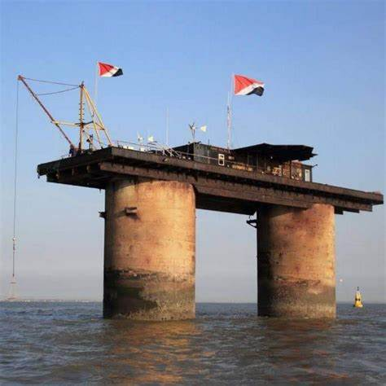

Slide 6
Matt 16:24- “If anyone would come after me, let him deny himself and take up his cross and follow me.”
Matt 16:25- “For whoever would save his life will lose it, but whoever loses his life for my sake will find it.”

Slide 7
Matt 17: 3- “…his face shone like the sun, and his clothes became white as light. ³ And behold, there appeared to them Moses and Elijah, talking with him.”

Slide 8
Matt 17: 5- “He was still speaking when, behold, a bright cloud overshadowed them, and a voice from the cloud said, “This is my beloved Son, with whom I am well pleased; listen to him.”

Slide 9
Will you follow God’s King?

